Slide 1
Business Idea Presentation (put your team/idea title here)
Template
(don’t change the order of the slides, but please change the look of them)

Slide 2
Background story
What led you into developing this idea?
What is the story?

Slide 3
Customer need
Who is your potential customer?
Potential customer = a person or organization who has the need you are targeting.
What possibly latent need are you targeting?
What problem customer has that he/she wants to get solved?

Slide 4
Product or service description
In as concrete terms as possible, describe how your product or service will function (solve the problem or satisfy the need customer has)
What is new or innovative about it?

Slide 5
Market Segment
Where are your potential customers?
How many potential customers you have in the area you are targeting?

Slide 6
Competition
Describe existing products, services or methods that customers currently use to satisfy their need.
Who are your direct and indirect competitors?
How much are your customers spending money or effort on these options at the moment?
How is your product or service better, cheaper or easier than these alternative methods?

Slide 7
Team and network description
Who are the team members and what relevant skills and experience they have
Who are the people in your support network

Slide 8
Current stage of the project
What have you accomplished so far?
What are the most important uncertainties of your idea at the moment?

Slide 9
Plan
Explain your plan and vision in three stages. Where is your company or project in the future?
Stage 1: After 12 months
Stage 2: After 3 years
Stage 3: After 5 years

Slide 10
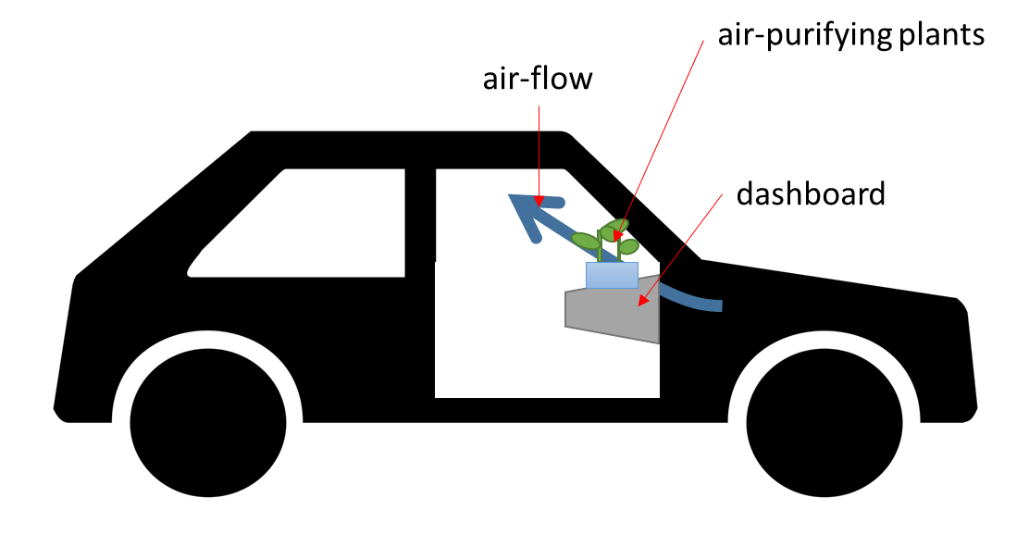
DON’T DO WALL OF TEXT. DO ILLUSTRATIONS AND ONLY FEW KEYWORDS PER SLIDE
Grassboard is a wide and flat pot, which is installed on top of the dashboard inside a car. Durable air-purifying plants species are growing in the pot. These plants capture the impurities. Plants get all of the light they need through the windshield. Driver needs to water the plants once every week. Small (sun powered) fans direct the air flow through the Grassboard.
Process:
1. Customer orders the Grassboard online,
2. installs it,
3. waters the growing medium, which includes the seeds and
4. waits for few weeks for the plants to starts growing,
5. water is added once a week.

