Slide 1
Business idea presentation template (put the name of the team / idea here)
If you wish, you can also put a concise catch phrase here which summarizes the business idea (do not change the order of the slides, but feel free to modify their appearance)

Slide 2
Problem
Describe here a general problem in the market or in the world that your product or service solves.
It can also be a need or challenge that your target customers face.
Who has the problem you aim to solve and how big is it?
Do not describe your product here yet.

Slide 3
Solution
On this page, describe how your product / service on which the business idea is based, solves the problem or need described on the previous page.
Describe how the product / service functions as concretely as possible.
What is new or innovative about the product / service?
If possible, connect the solution you offer with the big picture: how does the product / service improve the world by solving the mentioned problem?

Slide 4
Market potential
Describe here the market in which your product / service has potential
Evaluate both the size of the total market and the market share you are aiming for. How do you justify the estimates?
How many potential customers do you have in your planned business area?

Slide 5
Business model
What is your earnings model, i.e., where does the income come from?
At what price are you going to sell your product / service? Justify your decision.
How do you organize the production of your product / service?
How do you get customers and how does one buy the product / service?

Slide 6
Competitors
Who are your competitors and how does your business model / product differ from them?
What makes your solution / product / idea better than the competitors?
What are your weaknesses compared to existing solutions?

Slide 7
Team
Describe here who your team is and concisely describe the responsibilities of each team member in the team
Mention also the core competencies and experience of the team members regarding the business idea
Include a picture of each team member
You can also mention support networks outside the team if relevant to the business idea (e.g., mentors, advisors)
If the team is missing something and you are looking for certain skills, you can also mention it here

Slide 8
Plan
Describe your idea’s current status and future plans
What have you done so far and what situation are you in now?
What do you do next to advance the idea?
What are your short-term goals (e.g., 2-6 months) and long-term goals (e.g., 2-3 years)? Set numerically measurable goals as well.
What are the biggest uncertainties associated with the idea?
Note! If you are applying for Draft follow-up funding: explain what you have done and achieved since you received your previous Draft funding. This is important!

Slide 9
Your needs
Describe what you need to advance your idea further and realize its potential
For example, a certain amount of funding, contact or new expertise to the team
Also tell us how you plan to use the Draft funding.

Slide 10
Final impression
With this slide you should create a positive final impression for the listener
Add here the name of the business idea / team and a short catch phrase that summarizes your idea and mission or vision
Also include your contact information

Slide 11
INSTRUCTIONS:
The slideshow is shown to the jury during the pitch and therefore you should also make the appearance of the slides compelling with graphics, pictures, etc.
Do not fill the slides with too much text. Use large, simple images and just a few keywords per slide.
Practice your presentation with the clock in advance. Time limits are absolute and cannot be exceeded (1st funding round: 5 minutes. 2nd funding round: 5 minutes).
Consider what questions the jury might have for you.

Slide 12
Remember also:
The team must have at least 2 people, of whom at least one must be a UEF, Savonia or Sakky student, alumni or staff member.
The idea must not be aimed at advancing an existing company, i.e., one cannot plan to sell the developed draft idea to a 3rd party company.
In the first application round, the company may already be established, but it must not have any turnover.
When applying for further funding (2nd Draft round) turnover can be already made, but it is not a prerequisite for receiving funding.

Slide 13
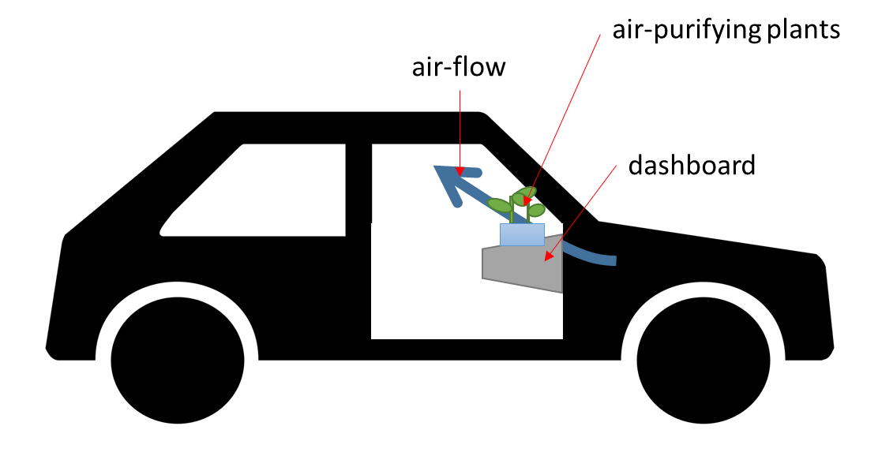
INSTRUCTIONS: Good and bad slide
Grassboard is a wide and flat pot, which is installed on top of the dashboard inside a car. Durable air-purifying plants species are growing in the pot. These plants capture the impurities. Plants get all of the light they need through the windshield. Driver needs to water the plants once every week. Small (sun powered) fans direct the air flow through the Grassboard.
Process:
1. Customer orders the Grassboard online,
2. installs it,
3. waters the growing medium, which includes the seeds and
4. waits for few weeks for the plants to starts growing,
5. water is added once a week.
Grassboard air-purifier
BAD
GOOD

